Slide 1
Linear regression: final notes

Slide 2
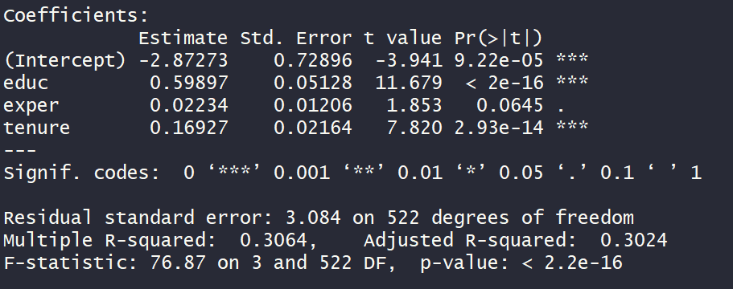
Goodness of fit
S/n | Predicted hourly earning | Actual hourly earning | Residual (=predicted – actual)
1 | 3.76 | 3.10 | 0.66
2 | 5.14 | 3.24 | 1.90
3 | 3.76 | 3.00 | 0.76
4 | 7.64 | 6.00 | 1.64
5 | 4.81 | 5.30 | -0.49
6 | 8.27 | 8.75 | -0.48
7 | 9.43 | 11.25 | -1.82
8 | 4.93 | 5.00 | -0.07
9 | 5.57 | 3.60 | 1.97
10 | 11.36 | 18.18 | -6.82

Slide 3
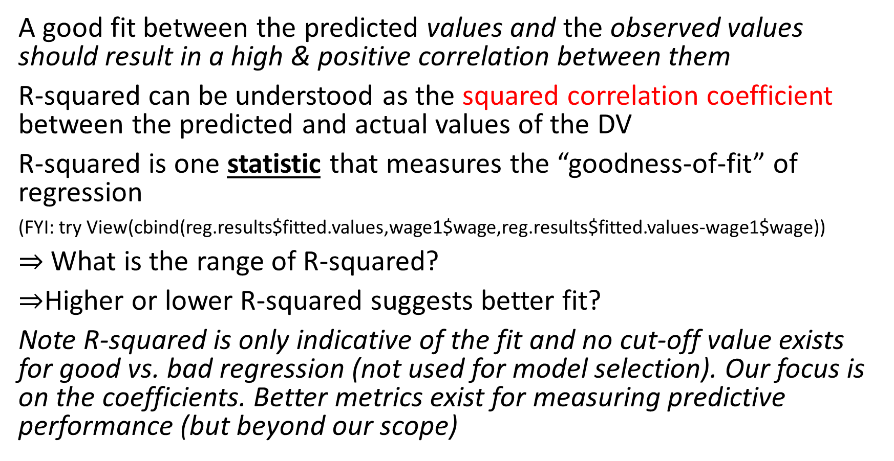
R-squared
A good fit between the predicted values and the observed values should result in a high & positive correlation between them
R-squared can be understood as the squared correlation coefficient between the predicted and actual values of the DV
R-squared is one statistic that measures the “goodness-of-fit” of regression
(FYI: try View(cbind(reg.results$fitted.values,wage1$wage,reg.results$fitted.values-wage1$wage))
$⇒$What is the range of R-squared?
$⇒$Higher or lower R-squared suggests better fit?
Note R-squared is only indicative of the fit and no cut-off value exists for good vs. bad regression (not used for model selection). Our focus is on the coefficients. Better metrics exist for measuring predictive performance (but beyond our scope)

Slide 4
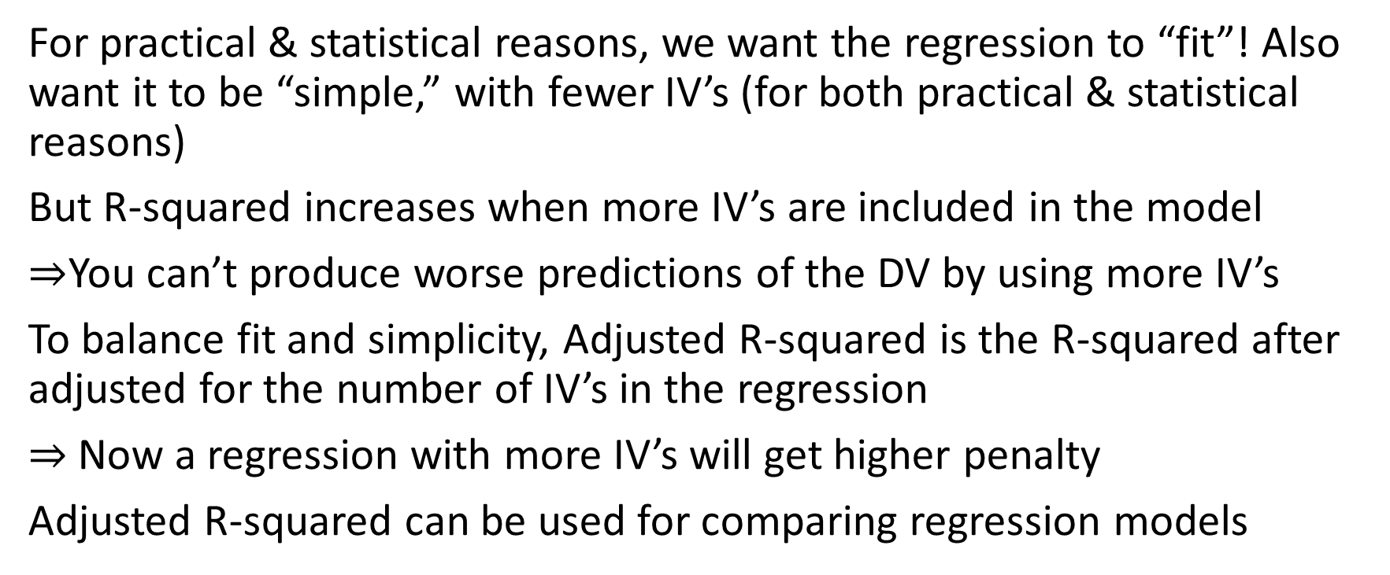
Adjusted R-squared
For practical & statistical reasons, we want the regression to “fit”! Also want it to be “simple,” with fewer IV’s (for both practical & statistical reasons)
But R-squared increases when more IV’s are included in the model
$⇒$You can’t produce worse predictions of the DV by using more IV’s
To balance fit and simplicity, Adjusted R-squared is the R-squared after adjusted for the number of IV’s in the regression
$⇒$Now a regression with more IV’s will get higher penalty
Adjusted R-squared can be used for comparing regression models

Slide 5
